Slide 1
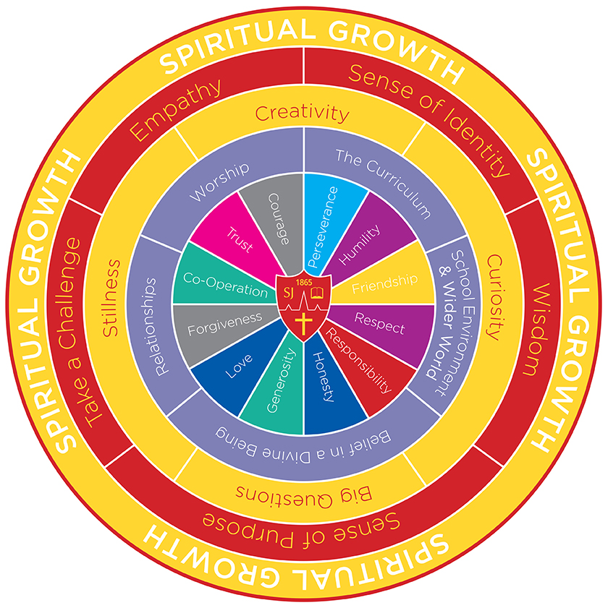
Year 5, Term 4: Extreme Time Travel: Ancient Maya (7 weeks)
WRITING: Main Outcomes: Narrative poetry: The Highway Man Instructions – Creation of an Ancient Maya game Planning and delivering performances: We look forward to inviting you to our Class Assemblies this term Wednesday 26th March – Class 11 Wednesday 2nd April – Class 12 | READING: Gibbon Island – pupil choice Guided Reading – Ashley Booth Extreme travel narratives Running Wild Kensuke’s Kingdom The Explorer The Storm Keeper’s Island Edge of the World | MATHS: Fractions, Decimal and Percentages (compare and order fractions, identify equivalent fractions knowing percentage and decimal equivalents of common fractions), Measurement: Length, Mass and Capacity (converting between different measurements, perimeter). | R.E.: U2.4 Christians and how to live - What would Jesus do?
 |  |  | COMPUTING: CRUMBLE Can I explain the term ‘variables’? Can I edit and add variables to a program? Can I use conditional statements (e.g. ‘when’…, ‘if…then’)? Can I use loops and conditions to refine algorithms? Can I use external inputs to control external outputs?
SPAG: Prepositional phrasing, adverbials, revision of word classes, figurative language for imagery, embedded clauses, cohesive devices, abstract/concrete/expanded nouns, parenthesis,
Science Living things and their habitats Can I comment on the life cycle of different animals, e.g., mammal, amphibian, insect bird? Can I explain the difference between different life cycles? Can I explain the process of reproduction in plants? Can I explain the process of reproduction in animals? Can I create a timeline to indicate stages of growth in humans? Can I describe changes as humans move to old age? | HISTORY: Can I discuss the legacy left by the Mayans? Can I talk about aspects of the daily life of the Mayans? Can I describe events from the past using dates when things happened? Ancient Maya workshop March 24th | DT: Can I show that I can be both hygienic and safe in the kitchen? Can I combine ingredients to make a savoury dish? Can I produce a detailed step by step plan? Can I explain how a product will appeal to a specific audience? | MFL: German Can I hold a simple conversation with at least 4 exchanges? Can I use my knowledge of grammar to speak correctly? Can I understand a short story or factual text and note the main points? Can I use the context to work out unfamiliar words? Can I write a paragraph of 4-5 sentences? Can I substitute words or phrases?
 | P.E.: Creative Cheltenham Town Football Real Gym Unit 2: Can I develop balance, agility and co-ordination, and begin to apply these in a range of activities?
 |  | Music:​ Can I describe and identify the structure of songs, using music vocabulary?​ Can I improvise and develop ideas short composition (hook)?​ Can I sing with expression and control and know how to sustain phrases, breathing at the right time in songs?​
 |  |  | P.S.H.E: Scarf plans - Living in the Wider World – Caring for the Environment
Theme Intent:
Behind the value of Humility, our topic turns to Ancient Maya understanding its importance and influence throughout the decades.
We will use other subjects to develop our understanding of the world around us and appreciating what everyone and everything has to offer.
Rules, Rights and Responsibilities will be spoken about, alongside caring for the environment and living in the wider world; children will sensitively be challenged to reflect on their actions, thoughts and emotions, and how they contribute positively to the world around them – Growing and Inspiring for Fullness of Life.
Oracy Focus:
Linguistic: To be comfortable using idiom and expressions.
Physical: To project voice to a larger audience.

